Slide 1
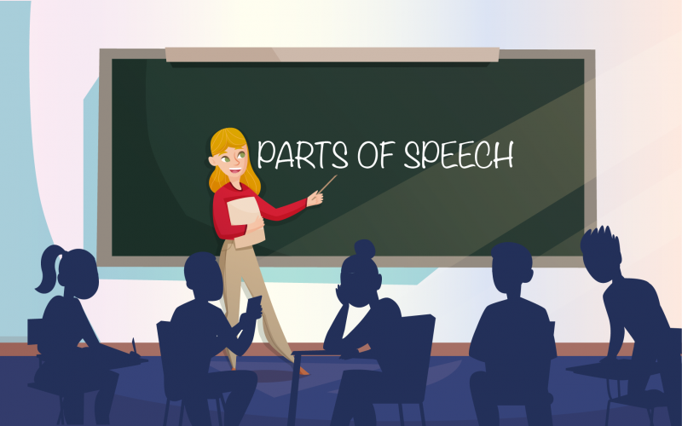

Slide 2

Definition
The part of speech indicates how a word functions in meaning as well as grammatically within the sentence.
An individual word can function as more than one part of speech when used in different circumstances.
It is important to understand that every word in a sentence has a job to do, or a role in the sentence.

Slide 3

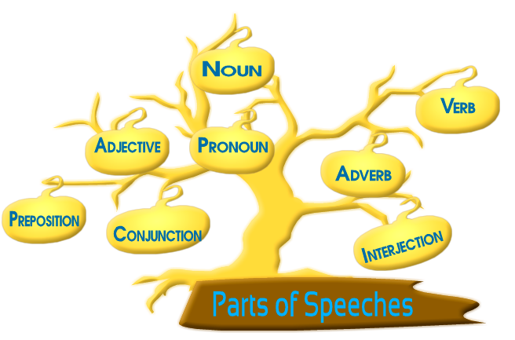
There are eight parts of speech in the English language but sometimes articles are also included in the list.

Slide 4
Poll Question
Which of the following is not a part of speech ?
Interjection
Adverb
Clause
Adjective

Slide 5



Answer
Option - C

Slide 6

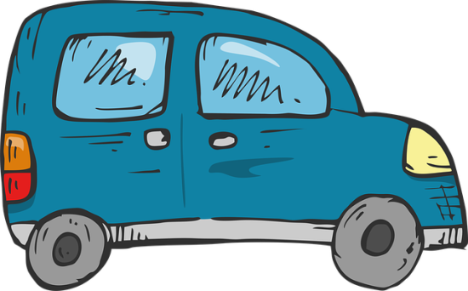
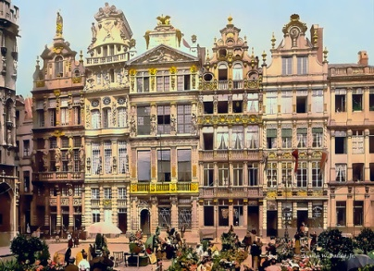



What is a Noun?????????
A noun is a………..

Slide 7

A NOUN is a word that refers to a thing (book), a person (Betty Crocker), an animal (cat), a place (Omaha), a quality (softness), an idea (justice), or an action (yodeling).
Person: Ms. Grace likes to eat spinach.
Place: I like Eiffel Tower the most.
Thing: To cook you need a couple of pots.
Quality: Honesty is a great value to possess.

Slide 8
Poll Question
Which of the following is not a noun in this sentence?
My doctor and my orthodontist are neighbors.
doctor
orthodontist
are
neighbors

Slide 9
Answer
Option- C

Slide 10
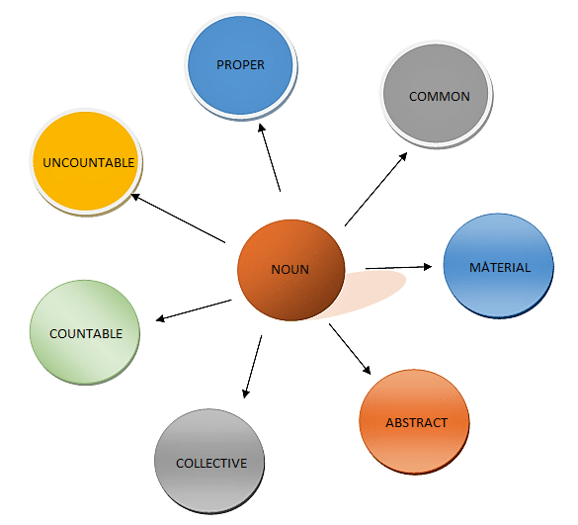
Kinds
Of
Nouns

Slide 11
Poll Question
Which of the following is a type of noun ?
Idioms
Articles
Abstract
Confusing words

Slide 12
Answer
OPTION- C

Slide 13

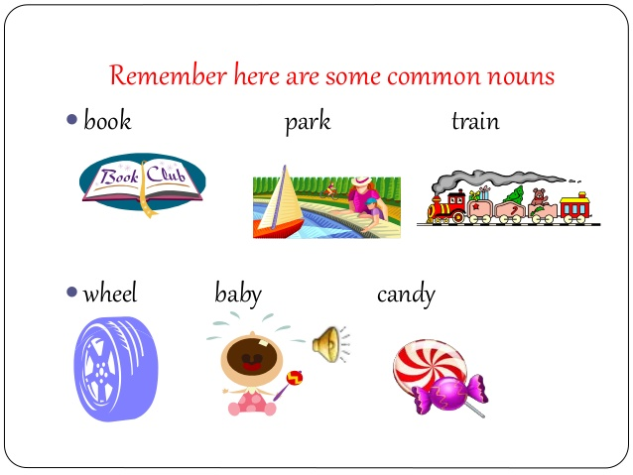

A COMMON NOUN refers to a person, place, or thing but is not the name of a particular person, place, or thing.
.

Slide 14
Poll Question
A ___________ noun does not name a specific person, place or thing.
A. Common noun
B. Proper Noun
C. Abstract Noun
D. Concrete Noun

Slide 15
Answer
Option - A

Slide 16
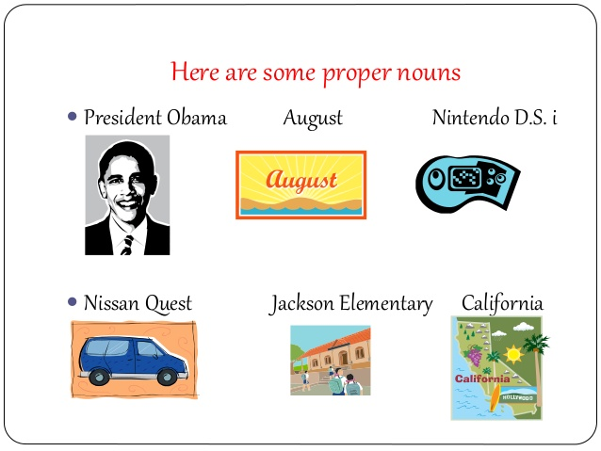
PROPER NOUN
A proper noun is the name of a particular person, place, or thing; it usually begins with a capital letter.

Slide 17
Poll Question
Which of the following is false about Proper Nouns ?
A. London, NewYork, Oprah winfrey are examples of proper nouns.
B. A proper noun represents the name of a specific person, place, or thing.
C. Proper nouns do not start with a capital letter.

Slide 18
Answer
Option -C

Slide 19
Activity – Choose Common & Proper Noun
teacher Mr. Johnson Emma toys
country man Indian Ocean website
Halloween candy January Lizard
lady day Helen Oreo

Slide 20

MATERIAL NOUN
A material noun is the name of material ,substance or ingredient which things are made of i.e. iron , copper and gold etc.

Slide 21
Note- A material noun is a type of common noun, but a distinction is made between the two. A common noun is usually a countable noun, but a material noun is an uncountable noun.
For example:- The cow gives us milk.
‘Cow’ is a common noun (countable ),but ‘milk’ is a material noun(uncountable).

Slide 22
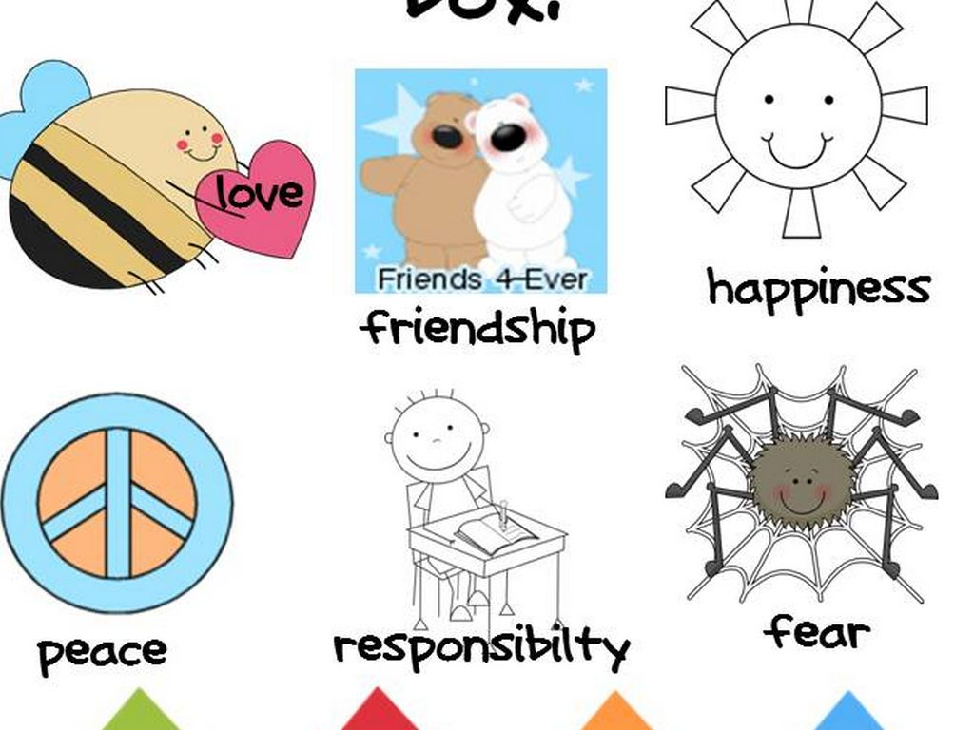
ABSTRACT NOUN.
An abstract noun is usually the name of a quality ,feeling ,action or state which can’t be perceived through five senses.

Slide 23
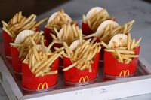

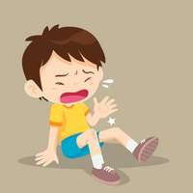

Poll Question:- Which image below shows a material noun?
A B
C D

Slide 24
Countable Noun
Countable nouns are those that refer to something that can be counted using numbers. They have both singular and plural forms. e.g. cat/cats; woman/women; country/countries.
Countable nouns can be used with articles such as a/an and the or quantifiers such as a few and many

Slide 25
Uncountable/Mass Nouns
Uncountable nouns are nouns that come in a state or quantity that is impossible to count; liquids are uncountable, as are things that act like liquids (sand, air). Abstract ideas like creativity or courage are also uncountable.
milk, water, ink, sugar, butter
(not, a milk, one water, two sugar)
They are always considered to be singular, and can stand alone or be used with some, any, a little, and much.

Slide 26
.
Uncountable nouns can be paired with words expressing plural concept. Here are some examples of how to format interesting sentences with uncountable nouns .
Advice – She gave me a useful piece of advice.
Bread – Please buy a loaf of bread.
When we want to refer to the quantity of these items, we use values of measurement which are countable:
How much milk do you need?
We need a litre of milk.

Slide 27
Difference b/w Countable & Uncountable Noun
 | Countable Noun | Uncountable Noun
Eg:- | Stars, Seconds, Rupees etc. | Money ,time ,knowledge etc.
Verb | Singular with Singular noun Plural with Plural noun | Singular
Adjective | Many, few, a number of , the number of | Much , little , quantity of
Article | A/An/the can be used | only ‘the’ can be used

Slide 28
Poll Question
Which of the following is a countable noun?
A. Money
B. Time
C. Rupees
D. Knowledge

Slide 29
Answer
Option- C

Slide 30
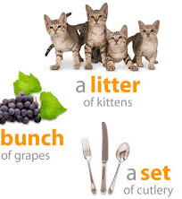
COLLECTIVE NOUN
A collective noun is the name of a group or collection of persons, animals or things regarded as a whole.

Slide 31
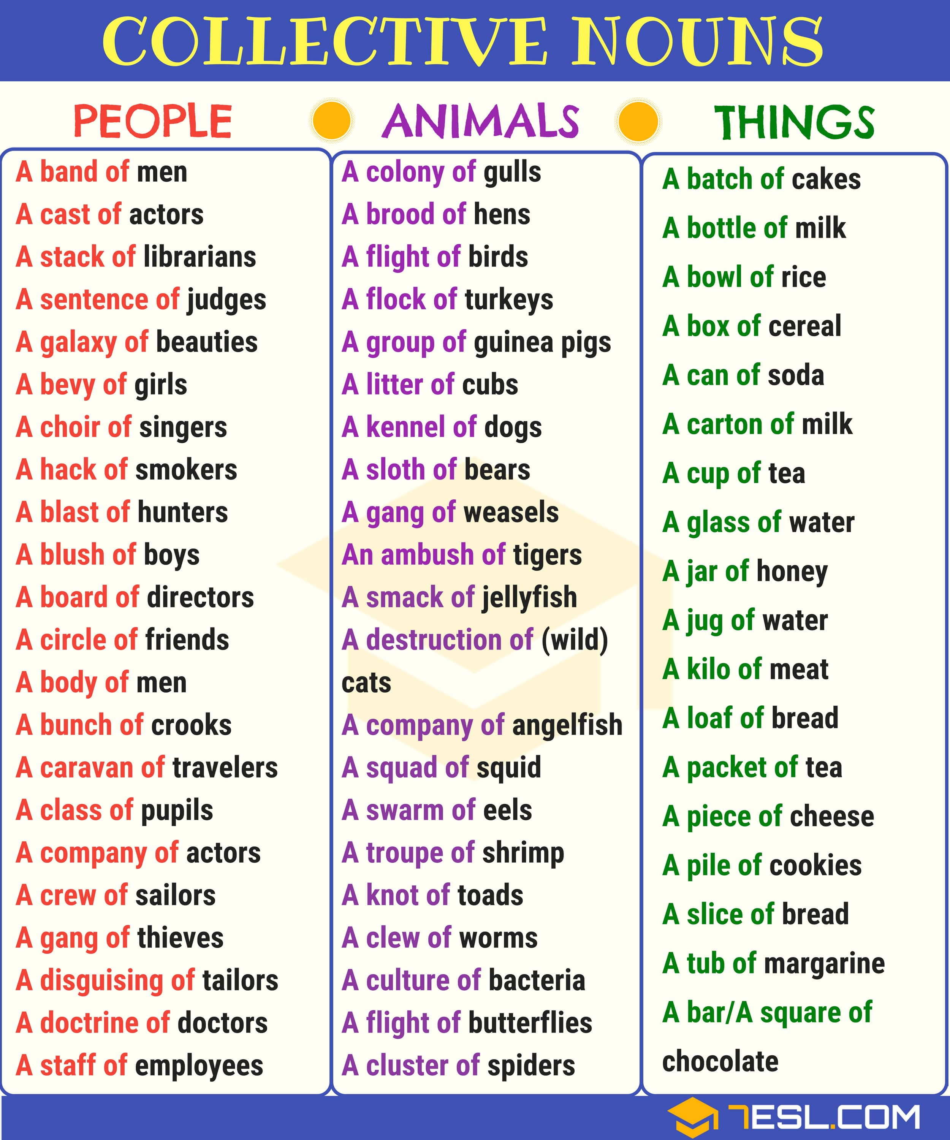

Slide 32
Poll Question
Which of the following is a collective noun?
(a) Island
(b) Bridges
(c) Ambush
(d) Women

Slide 33
Answer
Option- C

Slide 34
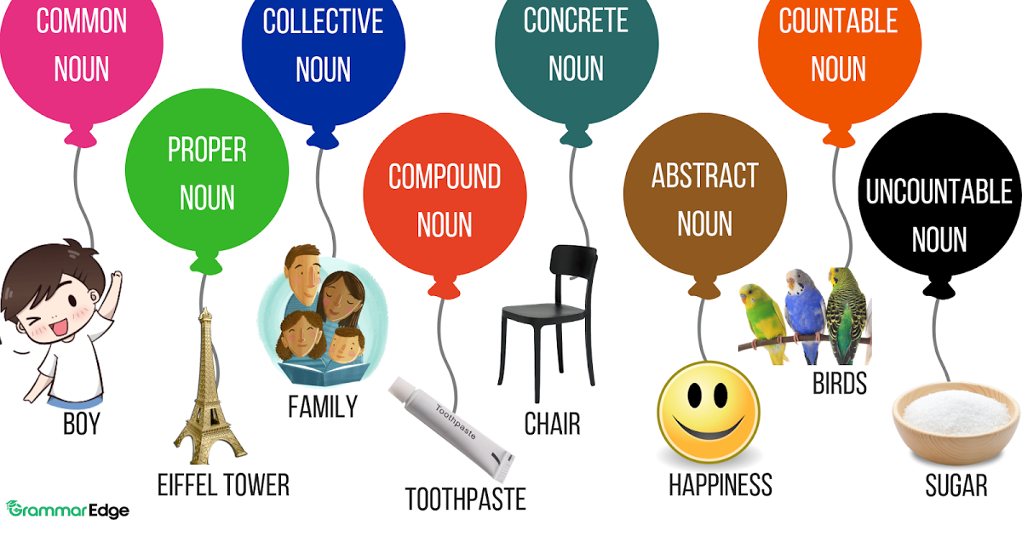
A Quick Review

Slide 35
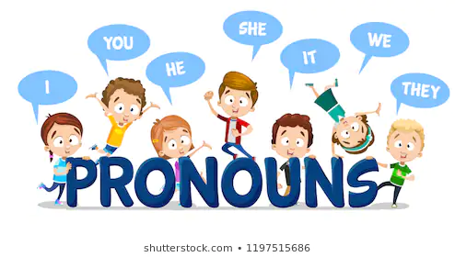
PRONOUN

Slide 36
What is a Pronoun???
A pronoun is a word that replaces a noun or a noun phrase. Words such as I, we, you, he ,him ,them etc. are called pronouns. E.g.
I asked Sam whether Sam knew Sam’s marks.
In this sentence- ‘Sam’(Noun) is repeated thrice. Therefore, to avoid this repetition , a pronoun should be used.
I asked Sam whether he knew his marks.
‘He’ ‘in this sentence stands for ‘Sam’ and ‘his’ for ‘Sam’s’.
Here, therefore ‘he’ and ‘his’ are pronouns.

Slide 37
Poll Question
What is pronoun?
A. A word that takes the place of a noun.
B. A word that takes the place of verbs.
C. A word that takes the place of adjectives.
D. A word that takes the place of adverbs.

Slide 38
Answer
Option- A

Slide 39
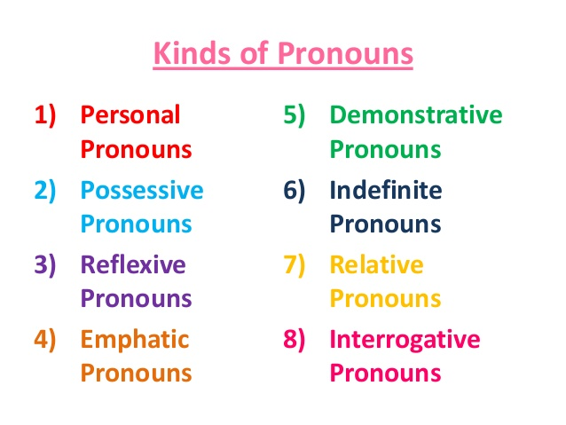

Slide 40
Poll Question
Which one of these is not a type of pronoun?
A. Reflexive
B. Relative
C. Derivative
D. Distributive

Slide 41
Answer
Option- c

Slide 42
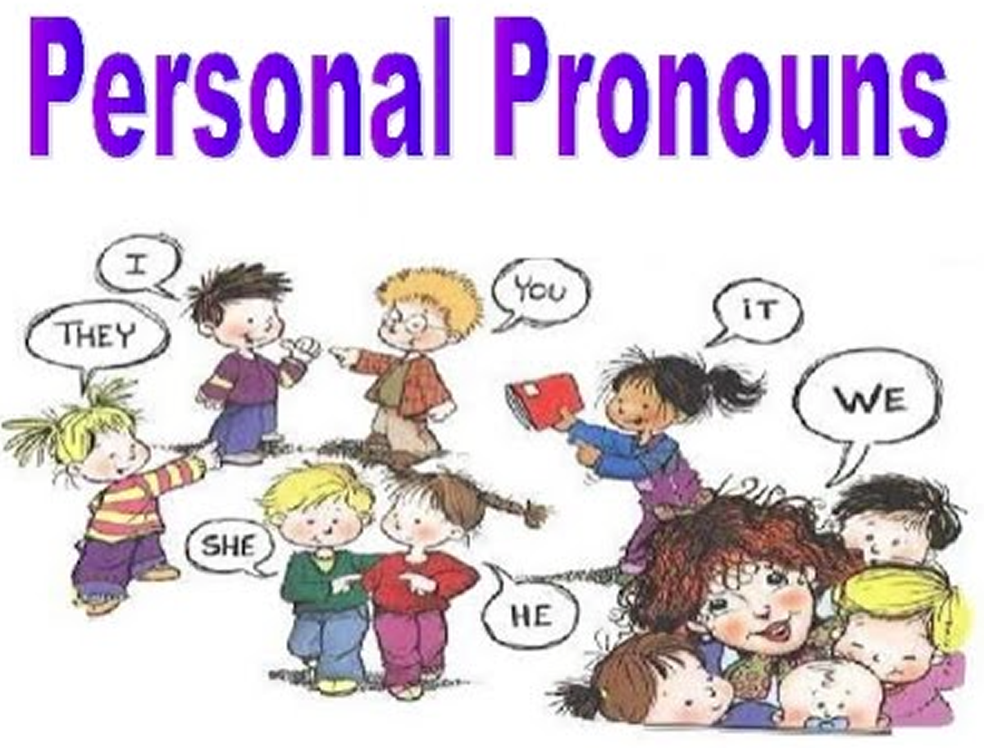
Personal Pronoun
They refer to a specific person or thing by indicating the person speaking, the person being addressed, or any other person or thing being discussed.

Slide 43
These are the pronouns which stand for the three ‘Persons’ the First Person , the Second Person , and the Third Person
The First person refers to the speaker or speakers ( I, We, etc.)
The Second person refers to the person or persons spoken to ( you )
The Third person refers to the person or thing (people or things ) spoken about ( he, she , him. They etc.)

Slide 44
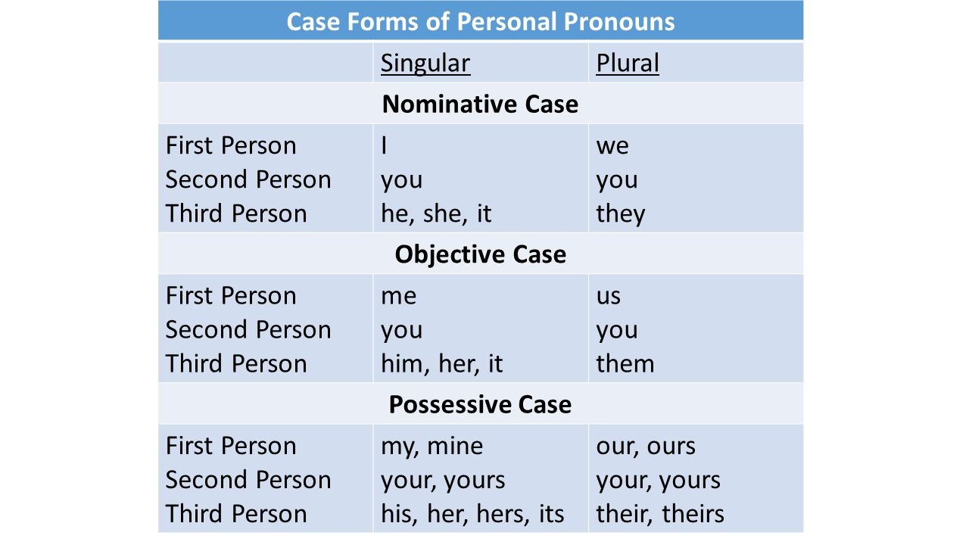
Personal Pronouns are used in their various cases and numbers.

Slide 45
Poll Question:-
The pronoun, her, is a . . .
A. 1st person nominative pronoun
B. 3rd person objective pronoun
C. 3rd person nominative pronoun
D. none of the above

Slide 46
Answer
Option-B

Slide 47
Make any student presenter and tell him to circle different types of pronouns.
He We Your
Our me they
You He my
I It us

Slide 48
Possessive Pronouns
Possessive pronouns show that something belongs to someone. The forms mine , ours ,yours , his , hers etc. are called possessive pronouns. They are used to express ownership/ possession/ relationship.
E.g. The kids are yours and mine.
Jane takes pride in Jane’s outfits.
It sounds odd to use Jane’s name twice in this sentence. A possessive pronoun solves the problem:
Jane takes pride in her outfits.

Slide 49
A possessive pronoun also tells us who owns a thing. However, a possessive pronoun is NOT followed by a noun:
Whose book is this?
Is it yours? yours book
Person | Singular | Plural
First | mine | ours
Second | yours | yours
Third | His, hers, its | theirs

Slide 50
Poll Question
Identify the case of the underlined pronoun in the following sentence.
After lunch, we completed the worksheets our teacher had given us.
Subject pronoun
Object pronoun
Possessive Pronoun
Adjective Pronoun

Slide 51
Answer
Option-B

Slide 52
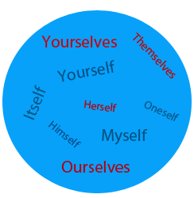
Reflexive Pronoun
‘SELF’ form of the personal pronoun i.e. words ‘myself’ , ‘yourself’, ‘himself’ are called reflexive pronoun. It refers or reflects back to a noun or pronoun already mentioned. It adds new information and cannot be removed from the sentence.

Slide 53
Reflexive pronouns are used when the subject and the object refer to the same person or thing. For Example:
I saw myself in the mirror.
He hurt himself while playing.
You should address the letter to yourself.
Each of the above bold words ( reflexive pronouns ) is the object of the verb in the sentence but refers to the same person as the subject.

Slide 54
Poll Question
In which of the following sentence , a reflexive pronoun is used?
A. The queen herself attended the party
B. She will do it herself.
C. I hurt myself trying to fix my father’s car
D. I heard the lie myself

Slide 55
Answer
Option- C

Slide 56
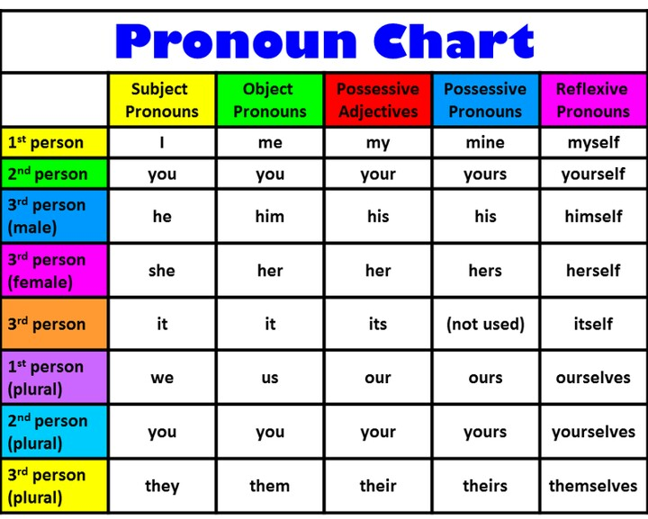

Slide 57
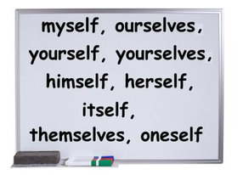
Emphatic Pronoun
Emphatic pronoun are pronouns used for highlighting, stressing or emphasizing the noun or pronoun that comes before it.

Slide 58
Emphatic pronouns can be omitted without changing the sense of a sentence.
For Example:
Joseph himself went to check the gate.
Mom drove me to school herself.
We intend to do all the work ourselves.
Did you yourself make the cake?

Slide 59
Notes:
The emphatic pronouns cannot be used as subjects. It is therefore wrong to say:

Slide 60
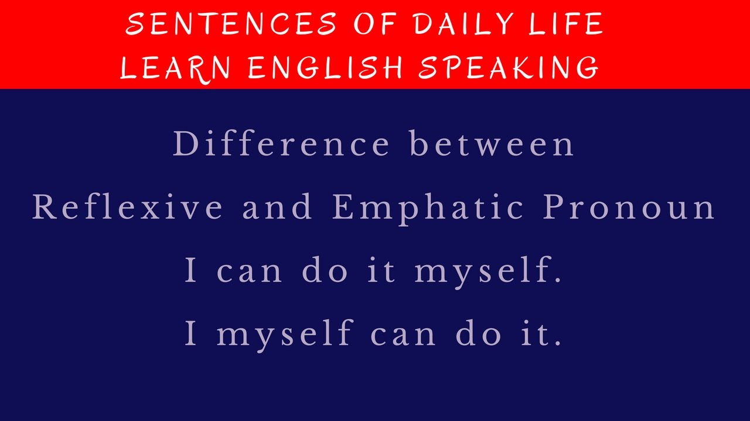
Difference between reflective and emphatic pronouns
Note that an emphatic pronoun can be removed from the sentence and the core meaning would not be affected. A reflexive pronoun, on the other hand, is indispensable. The sentence wouldn’t make complete sense if you remove the reflexive pronoun.

Slide 61
Poll Question –
State whether the pronoun is reflexive or emphatic.
Why are you shouting? We ourselves saw to stealing.
A. Emphatic
B. Reflexive

Slide 62
Answer
Option- A

Slide 63
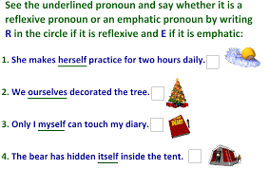
Activity- Make any student presenter

Slide 64
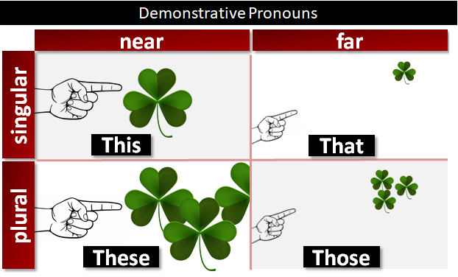
Demonstrative Pronoun
These pronouns point out people or objects. There are four demonstrative pronouns.

Slide 65
That is a long way to go.
This is my car.
After dinner , can you wash these ?
Can you give me the names of those who were absent?

Slide 66
‘This’ and ‘These’ are used for person or things that are near to the speaker. ‘That’ and ‘Those’ refer to the person or things that are farther away from the speaker.

Slide 67
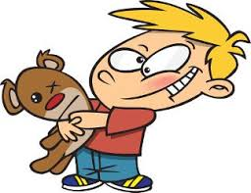
Poll Question:-
The correct demonstrative sentence according to the image is:
A. This is my teddy bear.
B. That is my teddy bear.
C. These are my teddy bear.
D. Those are my teddy bear

Slide 68
Answer
Option- A

Slide 69


Slide 70
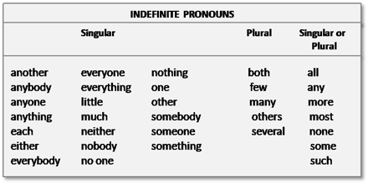
An indefinite pronoun is a pronoun that does not refer to a particular person, place, or thing .

Slide 71
Poll Question:-
What are Indefinite Pronouns?
A. Words to talk about experiences
B. Words to talk about someone or something without mentioning who or what specifically
C. Types of phrases
D. None of the above

Slide 72
Answer
Option- B

Slide 73
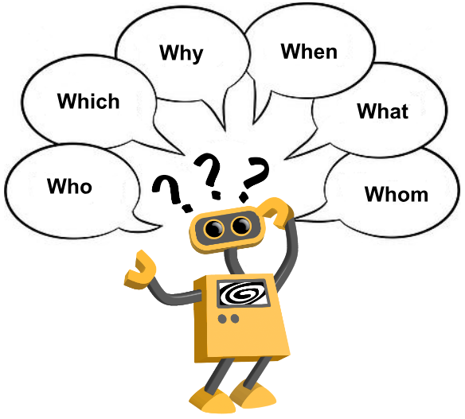
Interrogative Pronoun

Slide 74
Interrogative pronouns are used to frame questions. Words like Who (subject pronoun), Whom (object pronoun), Whose, What, which are known as interrogative pronouns. For Example:
Whose jacket is this?
Which of those girls do you like?

Slide 75
Poll Question:-
Choose the correct type of underlined word.
Who is my arch enemy?
A. demonstrative pronoun
B. relative
C. indefinite
D. Interrogative.

Slide 76
Answer
Option- D

Slide 77
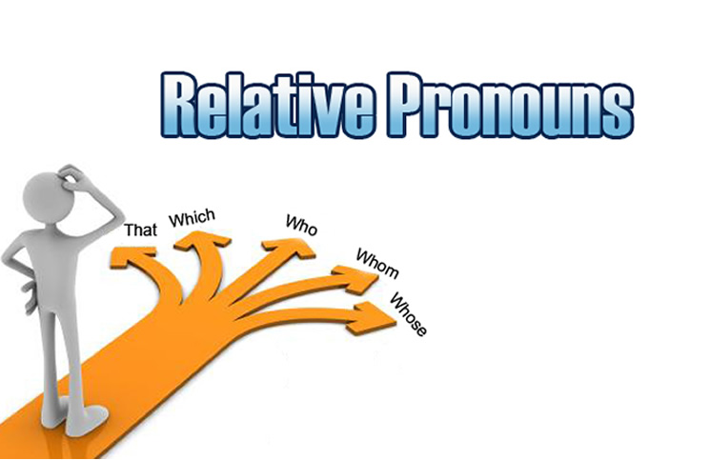

Slide 78
They reflect back to the noun of the sentence mentioned previously. Words like who, whoever, whose, whom, whomever, that, which, whichever, what, whatever are used as relative pronouns.
Example: The four team leaders, whomever the committee selects, will be at tomorrow’s meeting.
The cyclist who won the race trained hard.
Spaghetti, which we eat at least twice a week, is one of my family’s favorite meals.
The pants that I bought yesterday are already stained.

Slide 79

Poll Question:-
Choose the correct option.
The dancer ________was very talented won the contest.
A. whose
B. who
C. which
D. that

Slide 80
Answer
Option- B

Slide 81
Good ideas are not adopted automatically. They must be driven into practice with courageous patience……………….!
Thank you

